Slide 1


An Introduction to Main Street Database Services

Slide 2

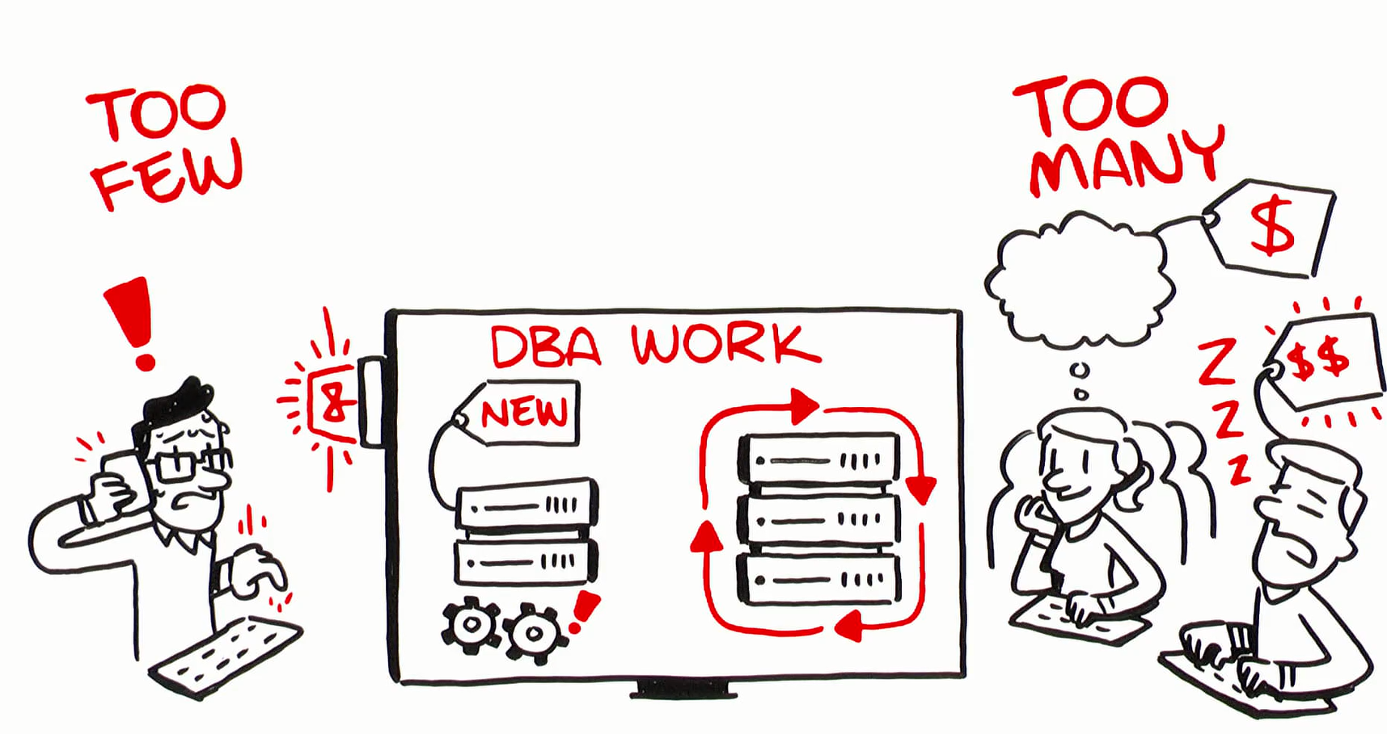






Our Niche
“We provide senior level DBAs to support to our customers for maximum flexibility in a model that aligns costs with usage.”
Service Features
Experienced, Assigned DBAs
100% U.S. Citizens
Direct Contact with DBAs
24x7 Incident Response
Integrated operational monitoring (optional)
Performance monitoring/assessment (optional)
Weekly Activity/Usage Reports
Service Benefits
Scalable DBA extension to team
No hiring or training costs
Pay-for-use model

